Slide 1





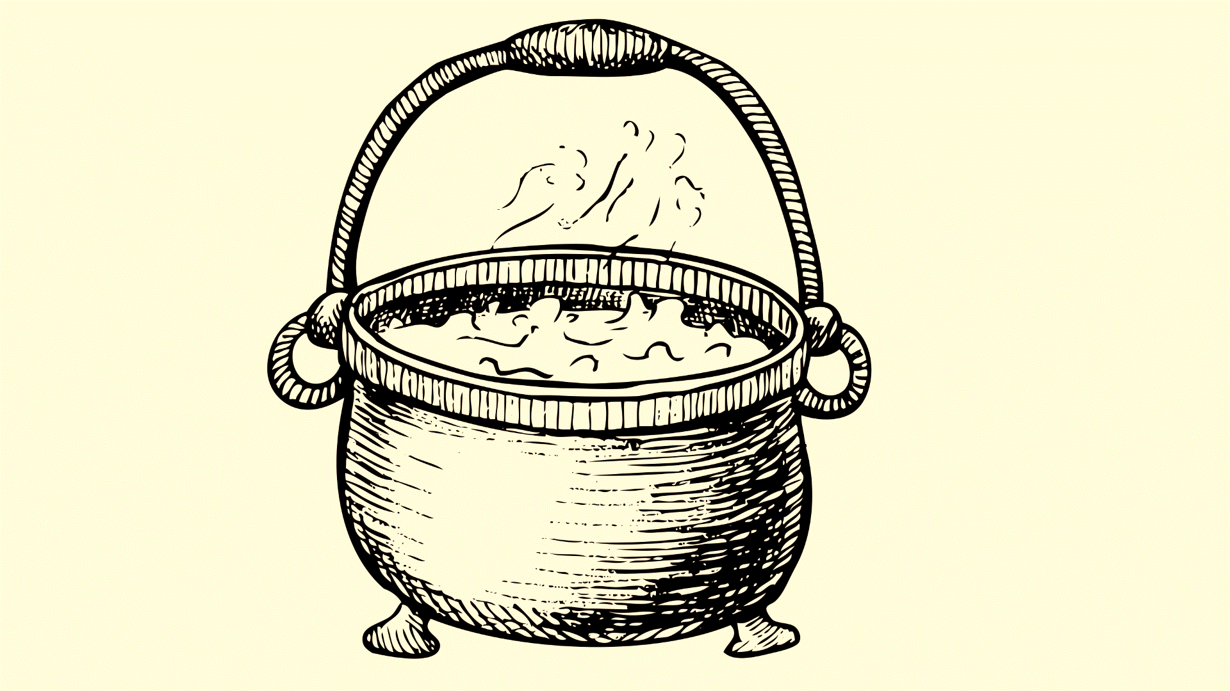










PRESENTED BY:-
ROHAN MALLICK (1SB21CS089)

Slide 2









Table of contents
01
04
TITLE
OBJECTIVES
02
LITERARY SURVEY
05
METHODOLOGY
03
PROBLEM STATEMENT
SYSTEM DESIGN
06

Slide 3


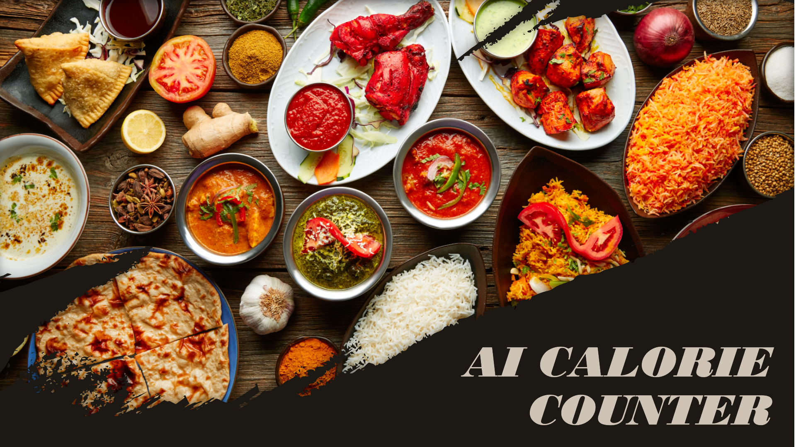




Slide 4










LITERARY SURVEY
https://ieeexplore.ieee.org/document/10083648
https://www.irjet.net/archives/V11/i4/IRJET-V11I4304.p df
https://ijesr.org/admin/uploads/CalorieWise%20Deep
%20Learning%20for%20Food%20Image%20Analysis%2 0and%20Calorie%20Estimation%E2%80%9D.pdf
https://ijcrt.org/papers/IJCRTAB02033.pdf

Slide 5


Advantages and disadvantages we found from Literary survey
Advantages
Accurate Calorie Counts: These systems use
Disadvantages
Challenges with Complex Foods: May struggle to accurately estimate calories for foods with irregular shapes.
Image Quality Matters: The accuracy depends on the quality of the photos; poor images can lead to incorrect estimates.
igh Computational Needs: Requires powerful computers for processing, which can be costly.
Privacy Issues: Storing and processing food images can raise privacy concerns.
Ongoing Maintenance: Needs regular updates and maintenance to stay accurate and
up-to-date.
advanced algorithms to provide precise calorie
estimates from food images.
Easy to Use: User-friendly interfaces make it simple for anyone to upload food photos and get calorie information.
Better Diet Management::elps users make healthier food choices by providing detailed calorie information.
Scalable: Can handle large amounts of data, making it suitable for widespread use.

Slide 6











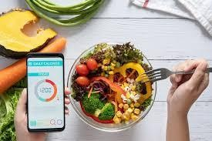



Problem Statement
an AI-powered calorie counter that uses image recognition to identify food items and calculates caloric content accurately. The system provides
real-time measurement of calorie intake for better health management.

Slide 7







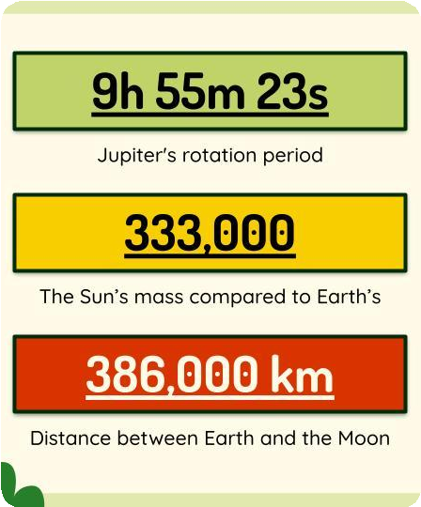
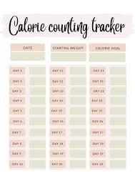




Objective
The objective of this project is to develop an AI-based calorie counter that leverages advanced machine learning and computer vision techniques to accurately recognize food items from images and estimate their calorie content. The system aims to provide a seamless user experience, enabling individuals to make informed dietary choices and manage their health effectively.

Slide 8
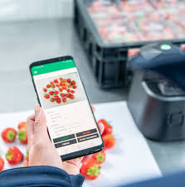
METHODOLOGY
1.RESEARCH DESIGN
This project employs a practical design to develop and deploy an AI-based health management application. The application utilizes machine learning and image recognition to identify food items from images and calculate their caloric content. The goal is to provide a real-time, user-friendly tool to help individuals manage their dietary intake.

Slide 9
2. Technology and Tools
2.1 Programming Language and Environment
The application is developed using Python and deployed using Streamlit for creating an interactive web interface. A LLM API is leveraged for image recognition and caloric content estimation. The application environment is managed using the dotenv library for secure handling of API keys and other environment variables.
2.2 Libraries and Dependencies
Streamlit: For building the web application interface.
PIL (Python Imaging Library): For handling image uploads and processing.
A LLM API: For generating content based on the input image and prompt.
dotenv: For managing environment variables securely.

Slide 10


3. Data Collection
Users upload images of food items through the Streamlit interface. The images are processed in real-time to extract relevant data.(The images supported are jpeg,jpg,png
4. Data Processing
The uploaded images are converted into a format suitable for the LLM API. The input_image_setup function handles image validation and conversion into the required MIME type.

Slide 11
5. Model Interaction
5.1 API Configuration
The LLM API is configured using the provided API key, ensuring secure and authenticated requests.
5.2 Content Generation
The core functionality of the application involves generating a response from the LLM. A function sends the image and a predefined prompt to the API, which returns the caloric content and details of the food items in the image.

Slide 12
6. User Interface
Streamlit Application
The Streamlit framework is used to build an intuitive user interface that allows users to input prompts, upload images, and receive caloric information. Key components include:
Text Input: For users to input custom prompts.
File Uploader: For uploading images of food items.
Image Display: To show the uploaded image.
Button Interaction: To submit the image for analysis.

Slide 13
7. Real-time Processing
Response Handling
Upon image upload and prompt submission, the application processes the image through the Google Gemini Pro Vision API. The API's response, containing caloric details, is displayed in the application interface.
8. Evaluation
Performance Metrics
The application will be evaluated based on:
Accuracy: The correctness of the identified food items and their caloric content.
Usability: User satisfaction and ease of use of the application interface.
Response Time: The time taken to process the image and return results.

Slide 14
9. Ethical Considerations
Ensuring the privacy and security of user data is crucial. The application will adhere to data protection regulations, ensuring that uploaded images and user inputs are handled securely and confidentially. Users are informed about the application's accuracy limitations and encouraged to seek professional dietary advice for personalized health management.
10. Limitations and Future Work
Current limitations include the reliance on the accuracy of the LLM API for food recognition and caloric estimation. Future improvements could involve integrating additional data sources, enhancing the model's accuracy, and incorporating features such as portion size estimation and nutrient breakdown.

Slide 15
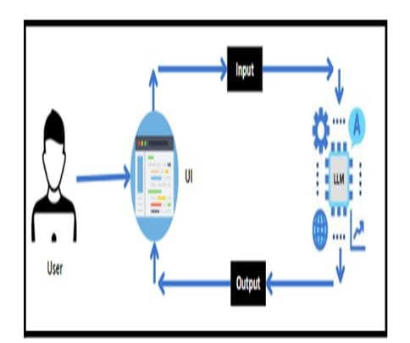
SYSTEM DESIGN

